Slide 1
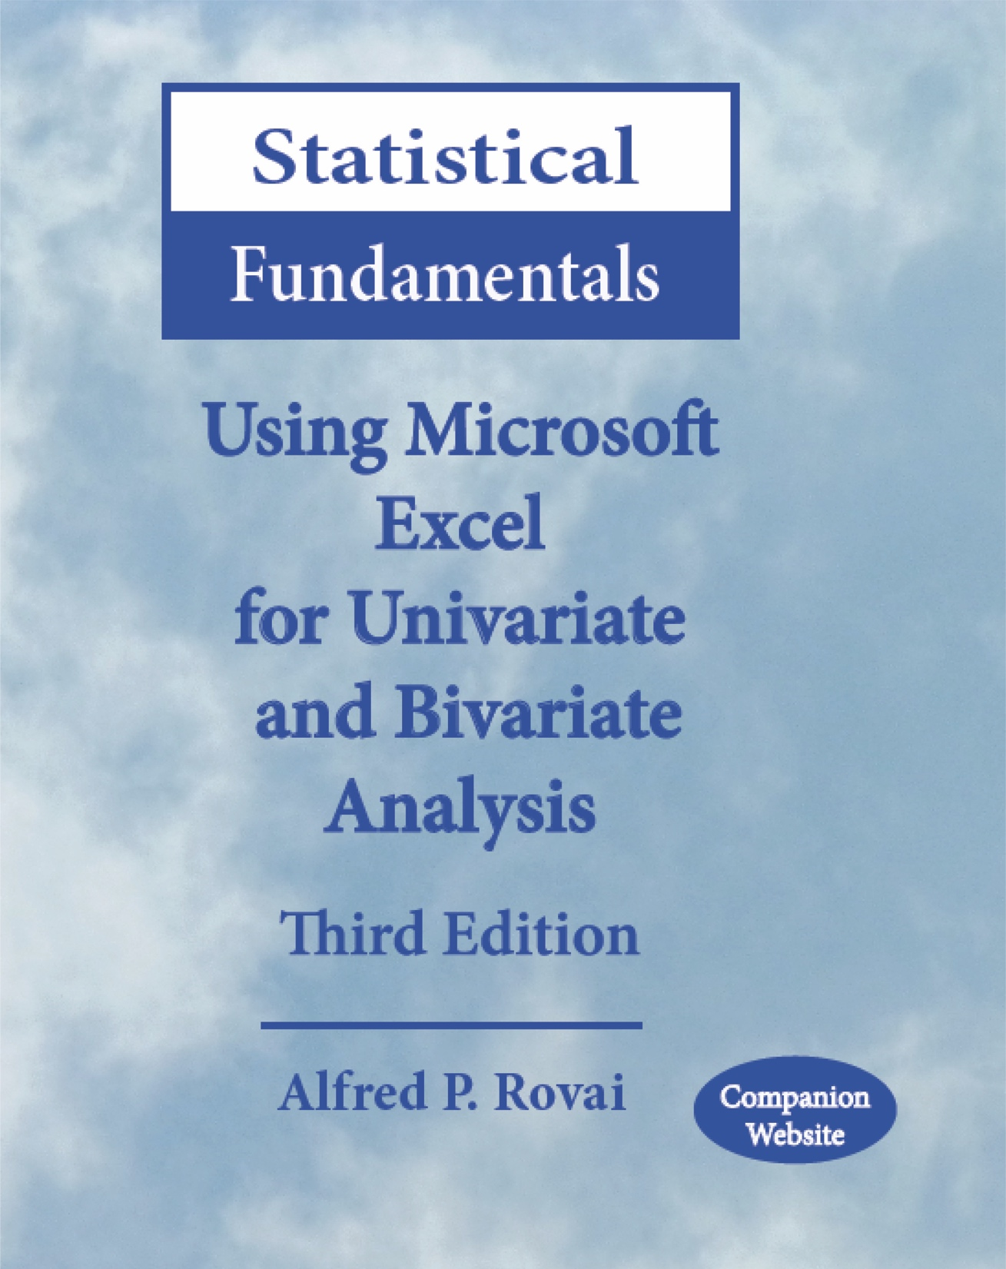
Statistical Fundamentals:
Using Microsoft Excel for Univariate and Bivariate Analysis
Alfred P. Rovai
Spearman Rank-Order Correlation Test
PowerPoint Prepared by
Alfred P. Rovai
Microsoft® Excel® Screen Prints Courtesy of Microsoft Corporation.

Slide 2
Spearman Rank-Order Correlation Test
The Spearman rank order correlation test (also known as Spearman rho) is a nonparametric symmetric procedure that determines the monotonic strength and direction of the relationship between two ranked variables.
Either the Greek letter ρ (rho) or r_{s} is used as the symbol for this correlation coefficient. It has a value in the range –1 ≤ r_{s} ≤ 1.
The absolute value of Spearman rho can be interpreted as follows:
  Little if any relationship < .30
  Low relationship = .30 to < .50
  Moderate relationship = .50 to < .70
  High relationship = .70 to < .90
  Very high relationship = .90 and above

Slide 3
Spearman Rank-Order Correlation Test
Excel data entry for this test is fairly straightforward. Each variable is entered in a sheet of the Excel workbook as a separate column.
Spearman rho is calculated as follows using raw scores.
where n is the number of pairs of ranks and d is the difference between the two ranks in each pair.
The following Excel function is used:
CORREL(array1,array2). Returns the correlation coefficient, where the two arrays identify the cell range of values for two variables

Slide 4
Spearman Rank-Order Correlation Test
The p-level for this correlation coefficient can be calculated using the t-distribution and the following t-value.
The degrees of freedom for this test is N− 2, where N is the number of cases in the analysis.
The following Excel function is used to determine the p-level:
T.DIST.2T(x,deg_freedom). Returns the t-distribution (2-tailed), where x is the numeric value at which to evaluate the distribution and deg_freedom is a number representing degrees of freedom.

Slide 5
Key Assumptions & Requirements
Random selection of samples to allow for generalization of results to a target population.
Variables. Two rank-ordered variables (ordinal, interval, or ratio data can be used).
Absence of restricted range. Data range is not truncated for either variable.
Independence of observations.
Monotonicity. Monotonic relationship between variables, i.e., a monotonic relationship is one where the value of one variable increases as the value of the other variable increases or the value of one variable increases as the value of the other variable decreases, but not necessarily in a linear fashion.

Slide 6
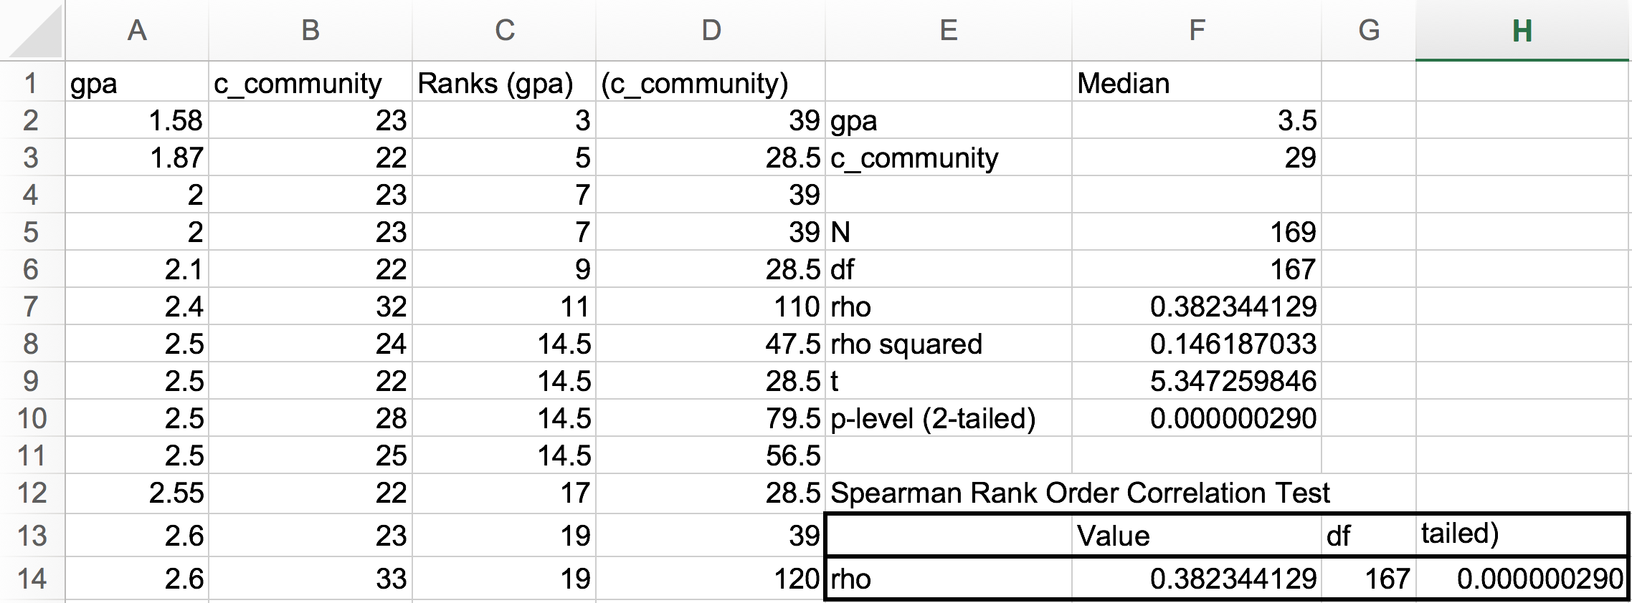
Conducting a Spearman Rank-Order Correlation Test
Open the dataset Motivation.xlsx. Click on the Spearman rho worksheet tab.
File available at http://www.watertreepress.com/stats
TASK
Respond to the following research question and null hypothesis:
Is there a relationship between grade point average (GPA) and sense of classroom community (c_community)?
H₀: There is no relationship between grade point average and sense of classroom community.

Slide 7
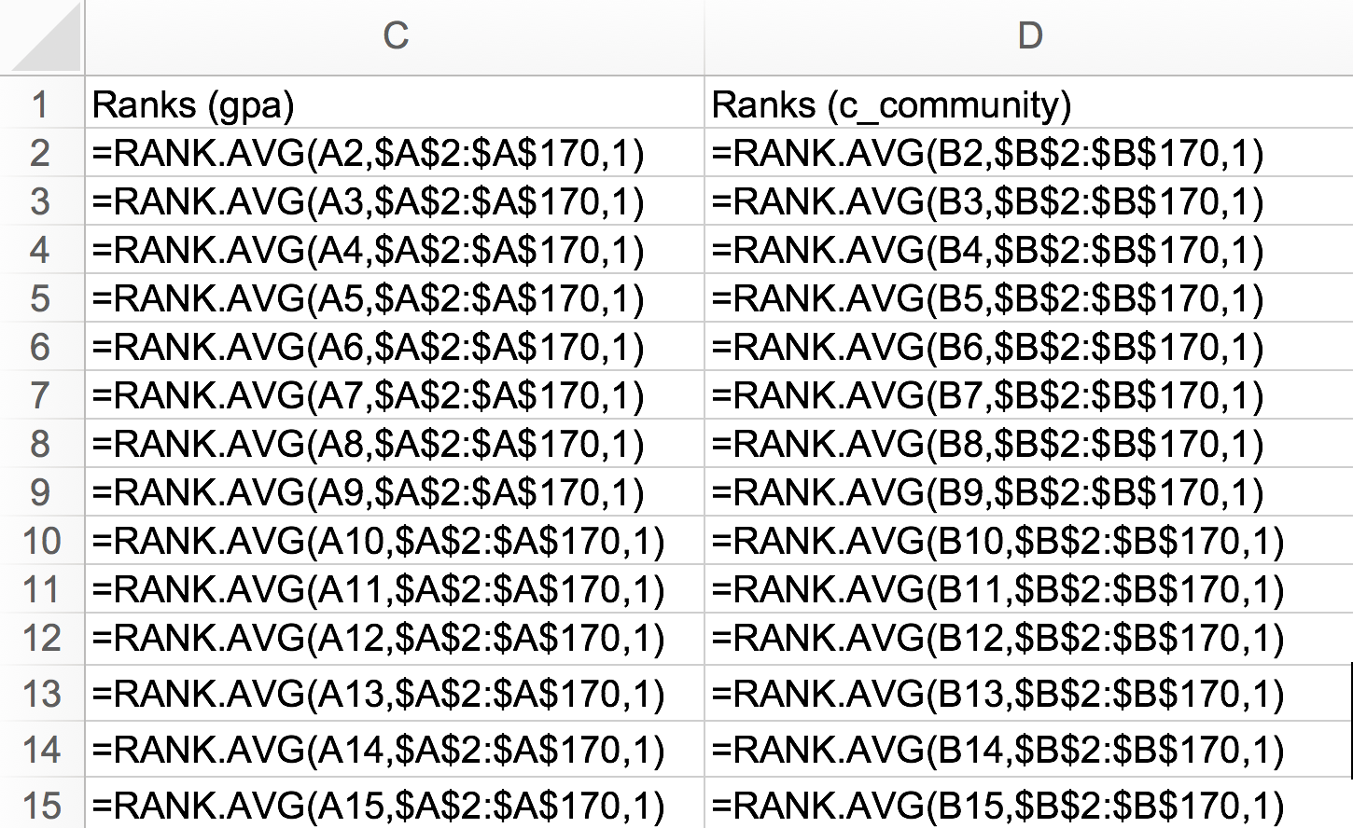
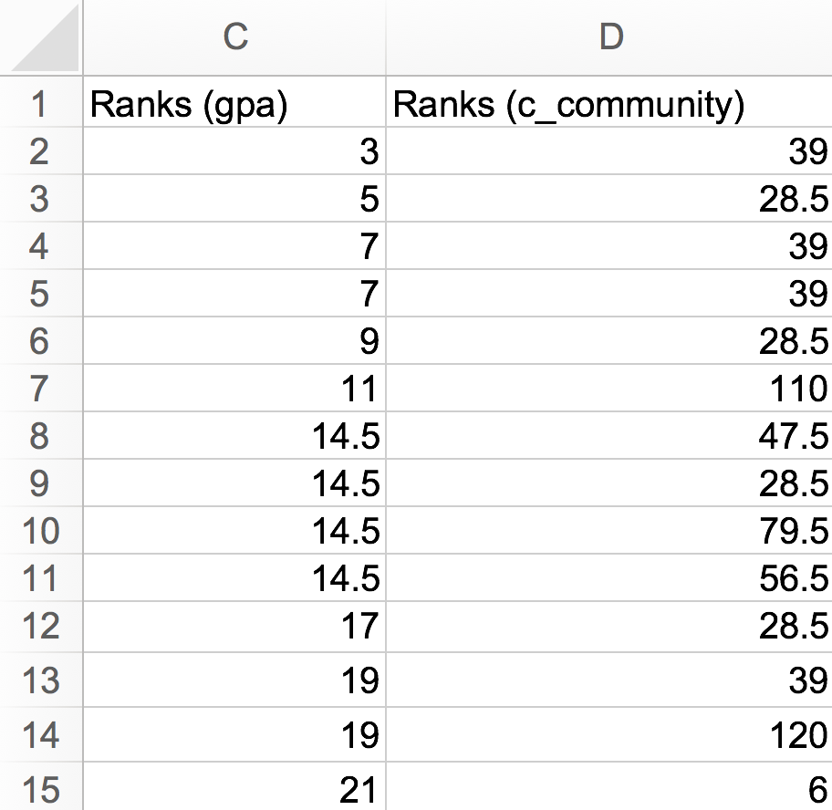
Conducting a Spearman Rank-Order Correlation Test
Enter labels and formulas in cells C1:D170 in order to generate ranks from raw scores for variables GPA and c_community.
Note: one can enter formulas in cells C2 and D2 and then use the Excel Edit > Fill > Down procedure for each variable.

Slide 8
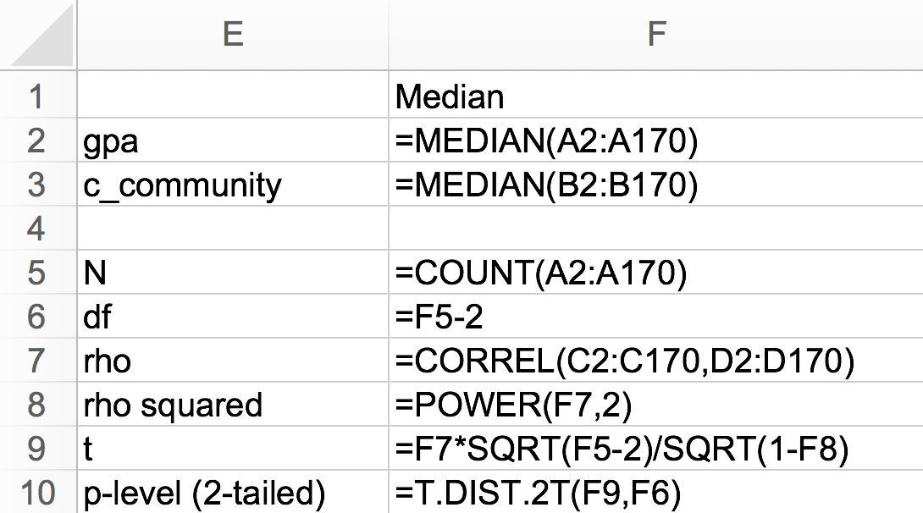
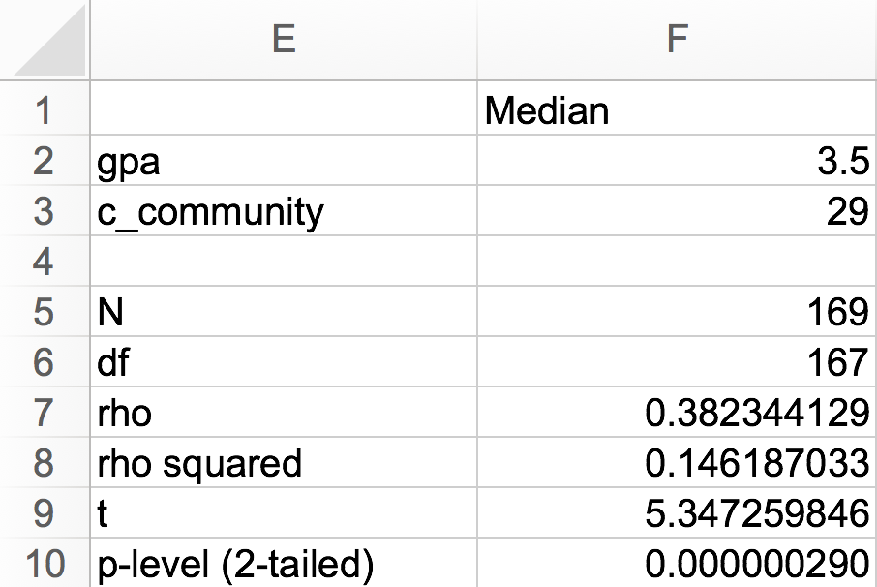
Conducting a Spearman Rank-Order Correlation Test
Enter the labels and formulas shown in cells E1:F10 in order to generate relevant statistics.
The results of the test provide evidence that grade point average (Mdn = 3.5) and sense of classroom community (Mdn = 29) are directly related, r_{s}(167) = .38, p <.001 (2-tailed). Therefore, there was sufficient evidence to reject the null hypothesis.

Slide 9
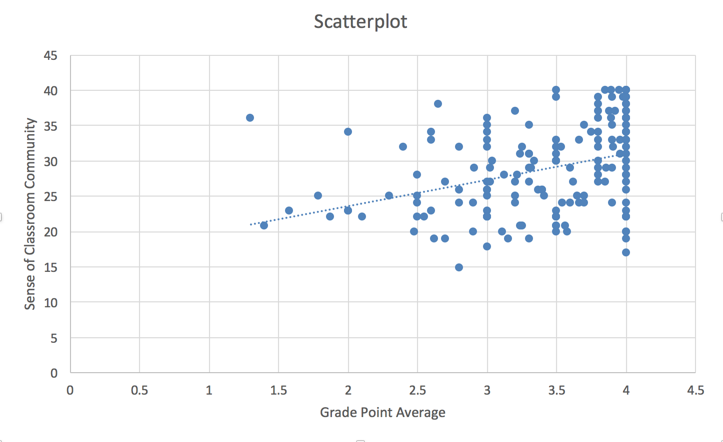
Scatterplot
The scatterplot shows a low, positive relationship between grade point average and sense of classroom community.
The trendline with positive slope shows a positiverelationship (as one variable increases, the other also increases).
The dispersed plots suggests a weak or low relationship (r_{s}(167) = .38).
Copyright 2015 by Alfred P. Rovai

Slide 10
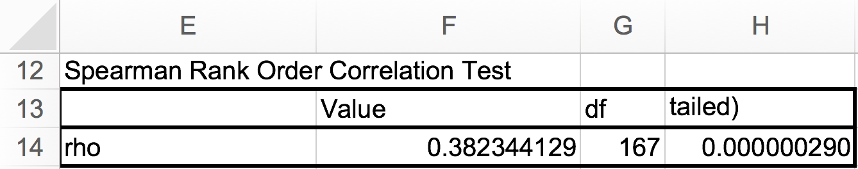
Test Results Summary
Test results provide evidence that there is sufficient evidence (p < 0.001) to reject the null hypothesis that there is no relationship between grade point average and sense of classroom community

Slide 11
Reporting Spearman Rank-Order Correlation Test Results
As a minimum, the following information should be reported in the results section of any report: null hypothesis that is being evaluated, descriptive statistics (e.g., M, SD, N for interval/ratio scale variables; Mdn, range, N for ordinal scale variables), statistical test used (i.e., Spearman rank order correlation test), results of evaluation of test assumptions, as appropriate, and test results. For example, one might report test results as follows. The formatting of the statistics in this example follows the guidelines provided in the Publication Manual of the American Psychological Association (APA).
Results
The Spearman rank order correlation test was used to evaluate the null hypothesis that there is no relationship between sense of classroom community and grade point average. The test showed a significant but low monotonic relationship between sense of classroom community and grade point average, r_{s}(167) = .38, p < .001. Consequently, there was sufficient evidence to reject the null hypothesis. The coefficient of determination was r_{s}² = .15, which indicates that sense of classroom community and grade point average share 15 percent of variance in common.

Slide 12
Spearman Rank-Order Correlation Test
End of Presentation

